Slide 1
Genetic Copy Number Pipeline Implementation and Analysis of Ovarian Germ Cell Tumors
Rahul Ram
Michael Heskett
Christopher Boniface
Paul Spellman, Ph.D

Slide 2
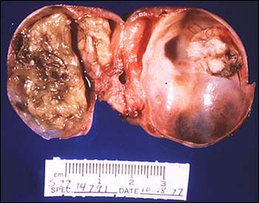
Types of Ovarian Tumors - Mature Teratomas
Mature Teratomas
Tumor made up of several different types of tissue such as hair, muscle, and bone
Cells are similar to normal cells
Generally benign, though can grow back after surgery
Occur in the sacrum of newborns or ovaries of women in their reproductive years
Arise from totipotent cells
Mature Teratomas
Kurman, R. J. (2014). WHO classification of tumours of female reproductive organs:.Lyon: Internat. Agency for Research on Cancer.

Slide 3
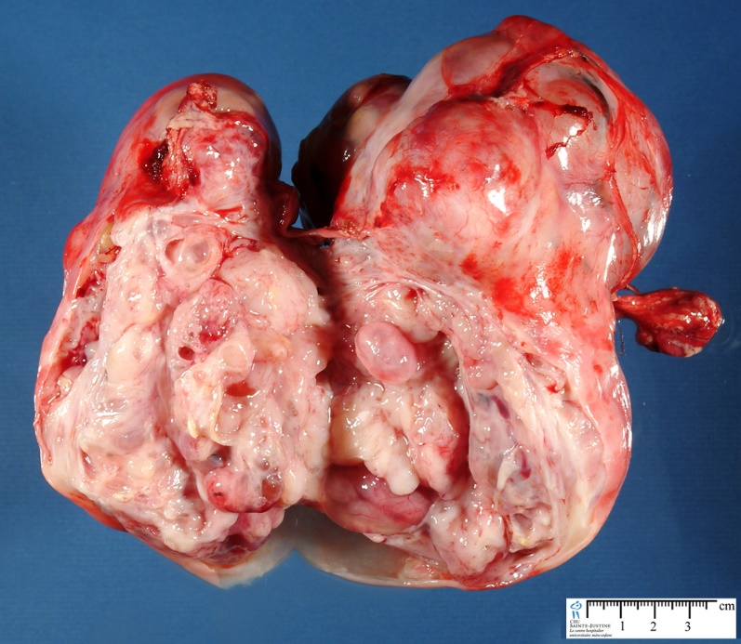
Types of Ovarian Tumors – Immature Teratomas
Immature Teratomas
Tumor made up of several different types of tissue such as hair, muscle, and bone
Cells are starkly different from normal cells
Generally metastatic
Contain excessive quantities of immature tissue including excessive neuroepithelium
Atypical mitotic activity
Second most common malignant ovarian germ cell tumor
Immature Teratoma
Kurman, R. J. (2014). WHO classification of tumours of female reproductive organs:.Lyon: Internat. Agency for Research on Cancer.

Slide 4
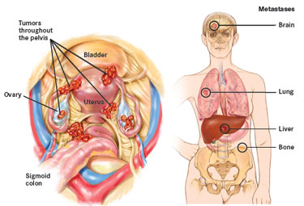
Types of Ovarian Tumors - Metastatic Tumors
Metastatic Tumors
Tumors formed through cancer cells breaking away from the original tumor
Pathologically similar to the original tumor
Most likely to end up in the liver, spleen, intestines, and brain
Most often affects menopausal women
Common Location of Metastatic Tumors
Kurman, R. J. (2014). WHO classification of tumours of female reproductive organs:.Lyon: Internat. Agency for Research on Cancer.

Slide 5
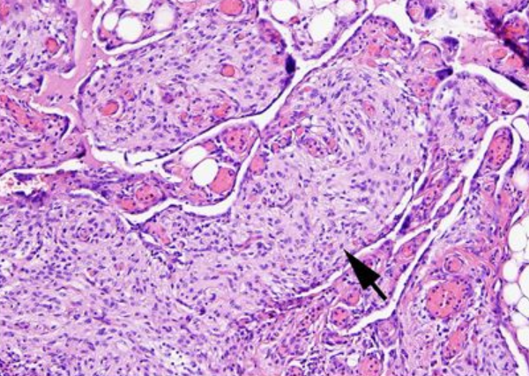
Types of Ovarian Tumors – Gliomatosis Peritonei
Gliomatosis Peritonei
Implantation of nodular, predominantly mature, glial tissue on the peritoneal surfaces of patients with ovarian teratomas.
Generally occurs in the later years of puberty
Can occur in mature and immature teratomas, though tends to show up in mature teratomas.
Tissue of Gliomatosis Peritonei
Kurman, R. J. (2014). WHO classification of tumours of female reproductive organs:.Lyon: Internat. Agency for Research on Cancer.

Slide 6
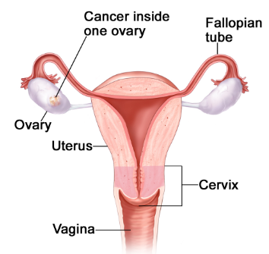
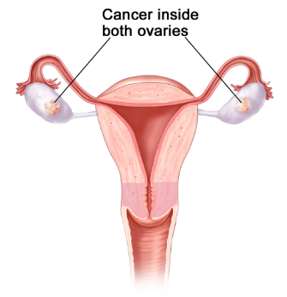
Types of Ovarian Tumors – Unilateral/Bilateral/Normal
Unilateral Case
Teratoma arises in one ovary
Bilateral Cases
Teratoma arises in both ovaries
Normal Tissue
Normal cells without any defects in the DNA
Unilateral Case
Bilateral Case
Kurman, R. J. (2014). WHO classification of tumours of female reproductive organs:.Lyon: Internat. Agency for Research on Cancer.

Slide 7
Overall Goal
Implement a copy number analysis pipeline
Pipleline should be…
Adjustable
Customizable
Automated
Conduct a copy number analysis on ovarian germ cell tumors
Copy number analysis should include
Chromosome location of copy number variation
Tumor fraction
Ploidy
Log₂ Ratio
Motivation
Little is known about the genomics of immature ovarian teratomas
Thus, it would be interesting to conduct a copy number analysis on it and compare it to other ovarian germ cell tumors.
This may shed more light on the origination of immature ovarian teratomas

Slide 8
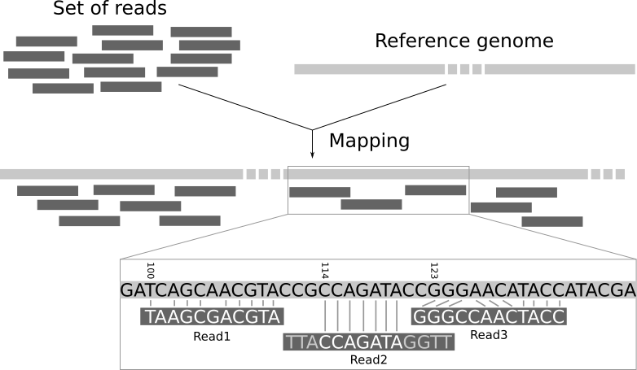
Mapping to a Reference Genome and Sorting
During DNA sequencing, DNA sequences called reads are outputted.
The locations of the reads are unknown.
Thus, mapping the reads to a reference genome determines the locations.
Reads are then sorted based on position
Mapping to a Reference Genome Diagram
http://bio-bwa.sourceforge.net/

Slide 9
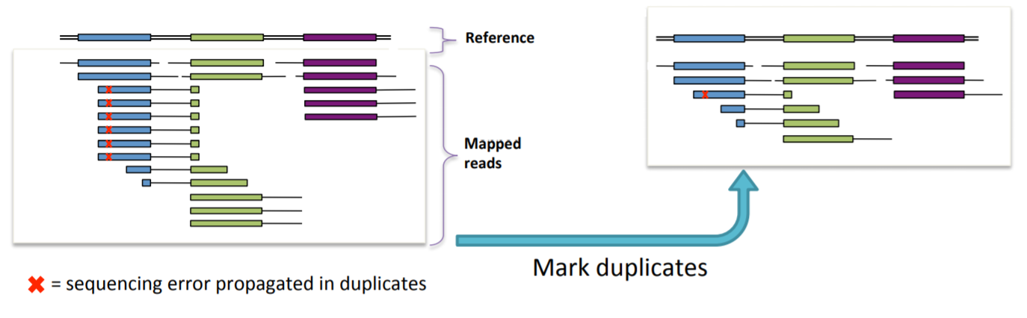
Marking Duplicates
Duplicates are sets of reads pairs that have the same unclipped alignment start and unclipped alignment end
Generally arise due to sampling of the exact same template of DNA
Selecting the best duplicate and removing the rest solves this problem
Marking and Removing Duplicates
https://software.broadinstitute.org/gatk

Slide 10
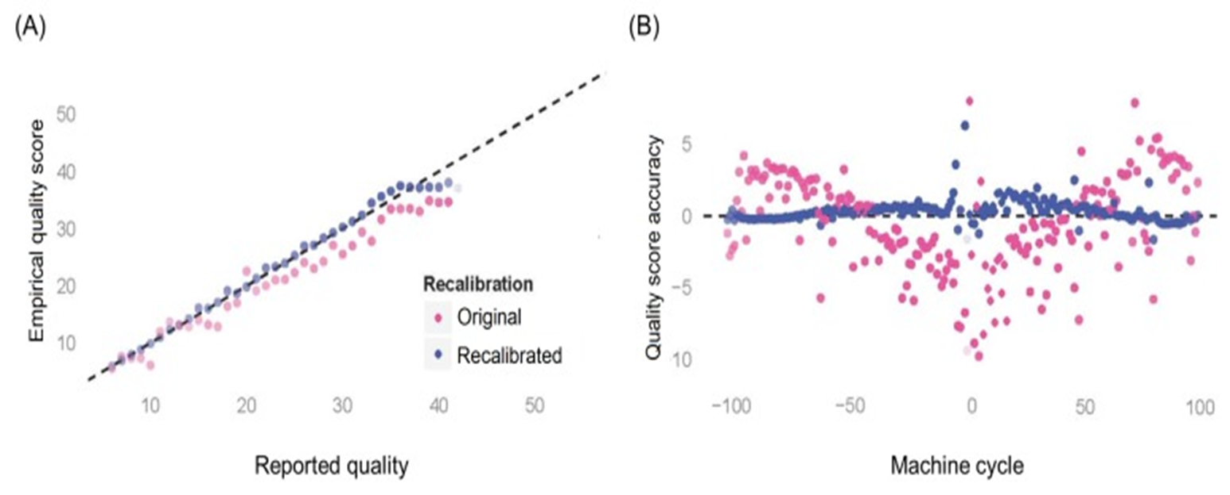

Base Recalibrator/Base Quality Score Recalibration
For each nucleotide base sequenced, it receives a confidence score detailing how likely the base is correct.
These probabilities are subject to errors and thus it’s necessary to recalibrate these scores
This accurately tells the program how much it can trust the sequenced nucleotide base
Will prevent mismatches in later analyses
This step consists of calculating the error and finding patterns
Example of Data Before and After Bias Correction
https://software.broadinstitute.org/gatk

Slide 11
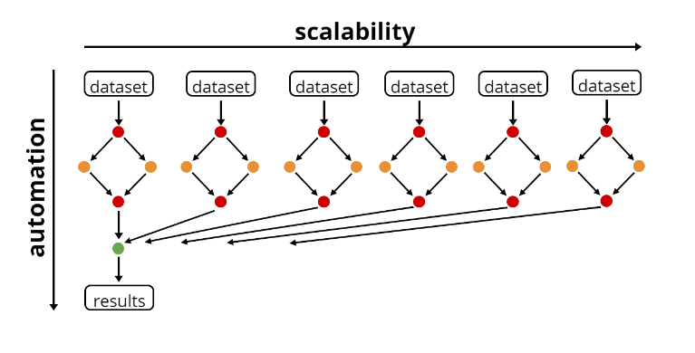
Snakemake
A workflow management system that allows for
Repeatable data analyses
Adjustable parameters
Scalability
Automation
Parallelization
Scalability and Automation of Snakemake
https://slides.com/johanneskoester/snakemake-short#/4

Slide 12
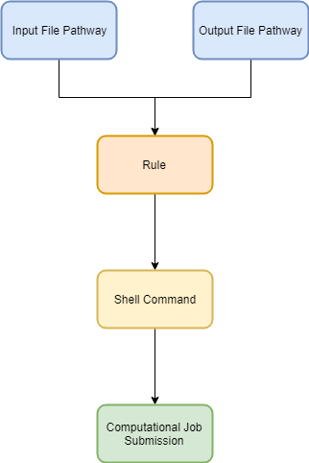
Snakemake Basics
Snakemake works by….
Reading a set of “rules” or steps
These rules divide into substeps by detailing how output files are created from input files
Automatically creating computational jobs based on a rule and its corresponding input and output file pathways
All previous steps were implemented into Snakemake
https://snakemake.readthedocs.io/en/stable/tutorial/tutorial.html

Slide 13
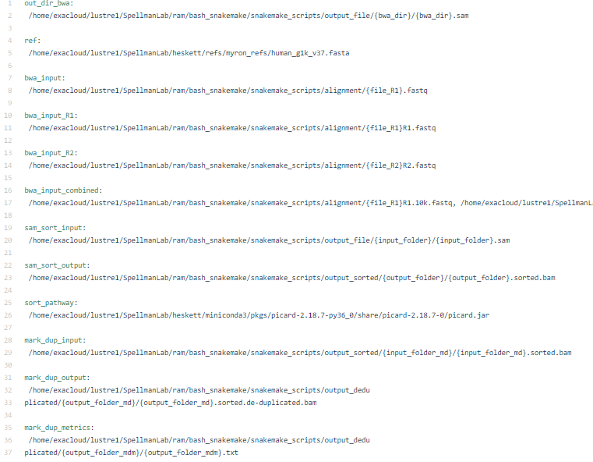
Snakemake Adjustability
Adjustability and Customization is a major part of Snakemake
This is accomplished through the config file.
The config file allows for parameters to be adjusted through a separate file instead of manual adjustment of code.
Example of a Config File
https://snakemake.readthedocs.io

Slide 14
Copy Number Analysis Study Design
Tumor samples taken from 12 patients
70 exomes including
Mature teratomas
Immature teratomas
Metastatic tumors
Gliomatosis Peritonei
Unilateral and Bilateral Cases
Matched normal tissue from the fallopian tube

Slide 15
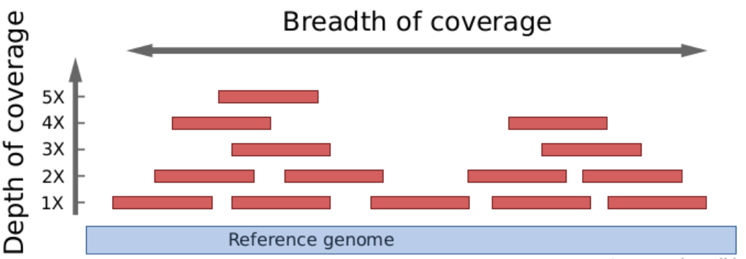
Coverage
Number of unique reads that contain a specific nucleotide sequence
Data contains low coverage in hopes of performing a low cost experiment
Coverage Diagram
www.metagenomics.wiki

Slide 16
IchorCNA vs CNVKit
Both attempt to run copy number analysis in order to predict the locations of copy number events
CNVKit
Requires relatively high coverage samples
Ineffective with the data
IchorCNA
Can use relatively low coverage samples
Relatively effective with the data
Viktor Adalsteinsson, Gavin Ha, and Samuel Freeman. Scalable whole-exome sequencing of cell-free DNA reveals high concordance with metastatic tumors. Nature (2017).

Slide 17
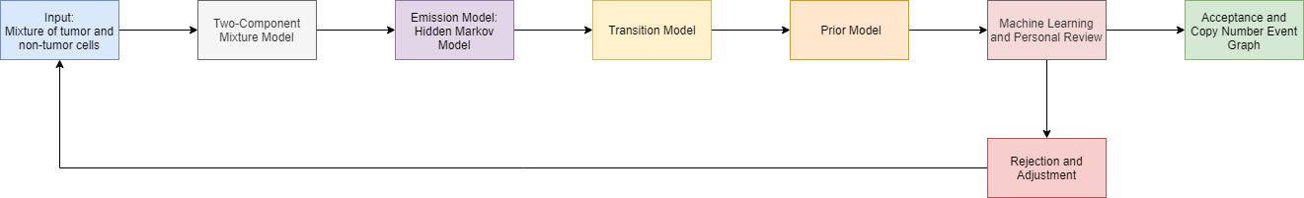
IchorCNA Method
Viktor Adalsteinsson, Gavin Ha, and Samuel Freeman. Scalable whole-exome sequencing of cell-free DNA reveals high concordance with metastatic tumors. Nature (2017).

Slide 18
Panel of Normals
Panel of Normals provides reference and reduces noise in the copy number analysis by normalizing the data
IchorCNA provides a default version
Custom version was generated from the normal samples
Normal sample 33 was excluded due to possible tumor contamination
Parameters
list of all normal file paths
Hg19 reference genome used
Mappability wig file for reference genome for bias correction
Hg19 centromere locations utilized
Used custom exons file to further normalization

Slide 19
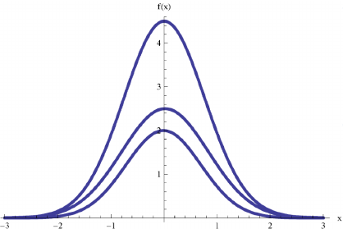
Two-Component Mixture Model
The copy number events in the processed reads are a mixture of DNA fragments derived from tumor and non-tumor cells.
Thus, it is necessary to create a two-component mixture model to determine the likelihood the copy number event is from the tumor cells.
This allows one to derive information about a cell without having to know whether the cell is a tumor or a non-tumor.
Example of Two-Component Mixture Model (TCMM). Top curve is the TCMM.
Viktor Adalsteinsson, Gavin Ha, and Samuel Freeman. Scalable whole-exome sequencing of cell-free DNA reveals high concordance with metastatic tumors. Nature (2017).
Kikawa, Cliff & Shatalov, Michael & Kloppers, P & Mkolesia, Andrew. (2015). Parameter Estimation for a Mixture of Two Univariate Gaussian Distributions: A Comparative Analysis of The Proposed and Maximum Likelihood Methods. British Journal of Mathematics & Computer Science. 12. 1-8. 10.9734/BJMCS/2016/16617.

Slide 20
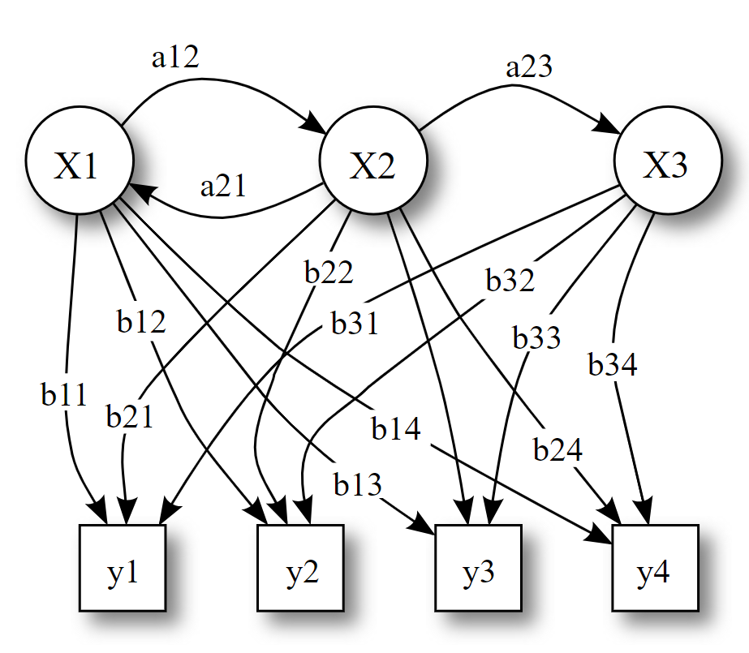
Hidden Markov Model
A Hidden Markov Model is utilized when there’s a previous observation on a data set, yet the state of the data is unknown.
This is ideal for this analysis since the copy number event for each read is unknown, yet the intensity of the effect is known.
Probabilistic parameters of a hidden Markov model
Viktor Adalsteinsson, Gavin Ha, and Samuel Freeman. Scalable whole-exome sequencing of cell-free DNA reveals high concordance with metastatic tumors. Nature (2017).

Slide 21
Parameters for Hidden Markov Model
Read count file paths provided
Ploidy of 2
Normal Contamination ranging from .5 to .95
Reference Genome of Hg19 Utilized
Mappability Wig File of Hg19 Utilized
Centromere locations provided
Chromosome Analysis ranging from 1 to 22 and only on X Chromosomes

Slide 22
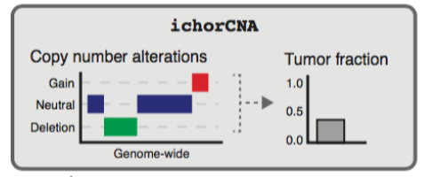
Transition Model
Types of copy number state include gains, neutral, and deletions
Transition Model is utilized to model the probability for each copy number state
The event with the highest probability was outputted
Types of Copy Number Events
Viktor Adalsteinsson, Gavin Ha, and Samuel Freeman. Scalable whole-exome sequencing of cell-free DNA reveals high concordance with metastatic tumors. Nature (2017).

Slide 23
Prior Model and Machine Learning
Prior model was utilized to determine the probability the transition model would output the correct result given the listed assumptions
Finally, a machine learning algorithm was implemented to assess the accuracy of the copy number analysis
The algorithm would learn from the copy number analysis and predict the copy number events more accurately.
Viktor Adalsteinsson, Gavin Ha, and Samuel Freeman. Scalable whole-exome sequencing of cell-free DNA reveals high concordance with metastatic tumors. Nature (2017).

Slide 24
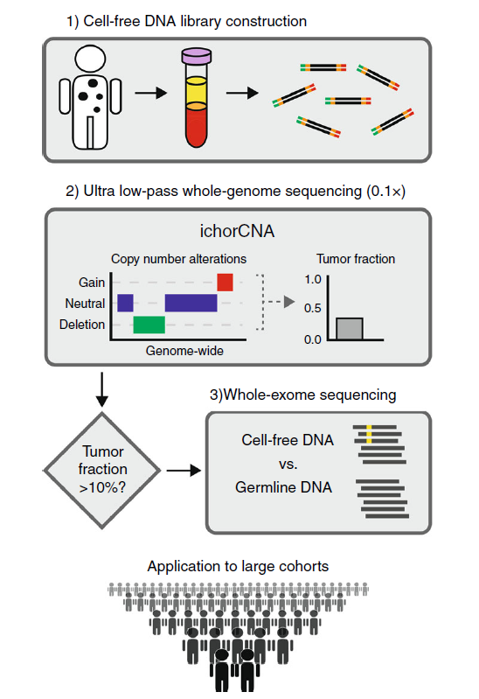
Log2 Ratio and Tumor Fraction
Log2 Ratio
Shows the ratio between tumor and normal DNA.
Tumor Fraction
A tumor fraction is outputted based on the number of copy events in the genome
States the amount of tumor DNA present in the sample
Tumors can have a tumor fraction of 0.
Means the alteration proportion was < 0.05
Tumor Fraction Resulting from low-pass whole-genome sequencing
Viktor Adalsteinsson, Gavin Ha, and Samuel Freeman. Scalable whole-exome sequencing of cell-free DNA reveals high concordance with metastatic tumors. Nature (2017).

Slide 25
Problems
Some sample have a non-two ploidy
Some samples are too noisy
Some samples contain too much normal contamination

Slide 26
IchorCNA Graphical Results

Slide 27
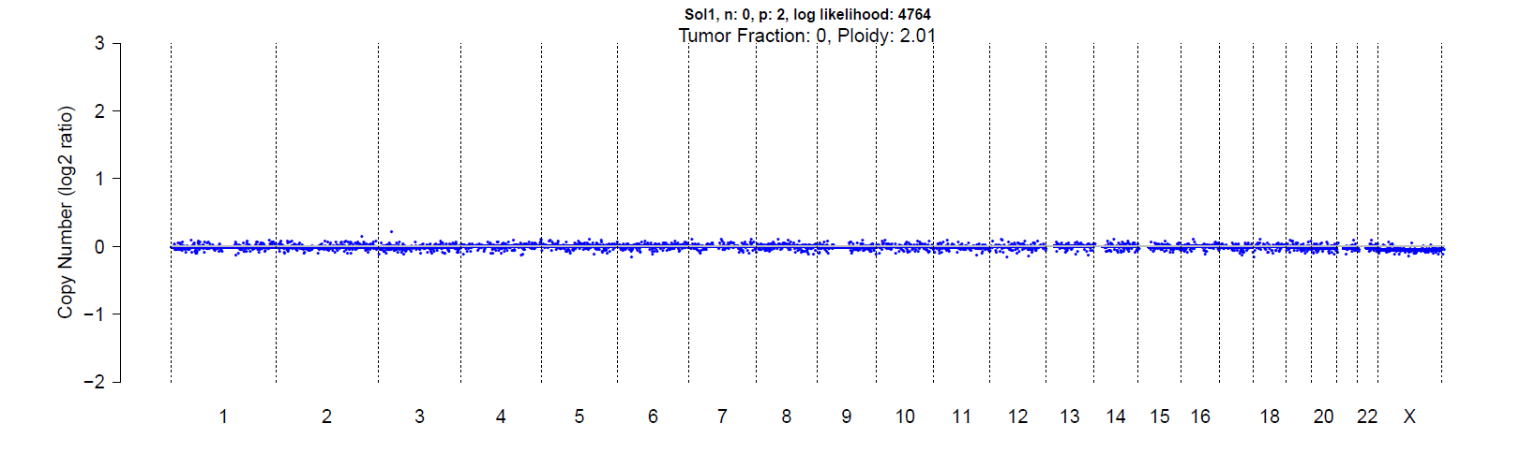
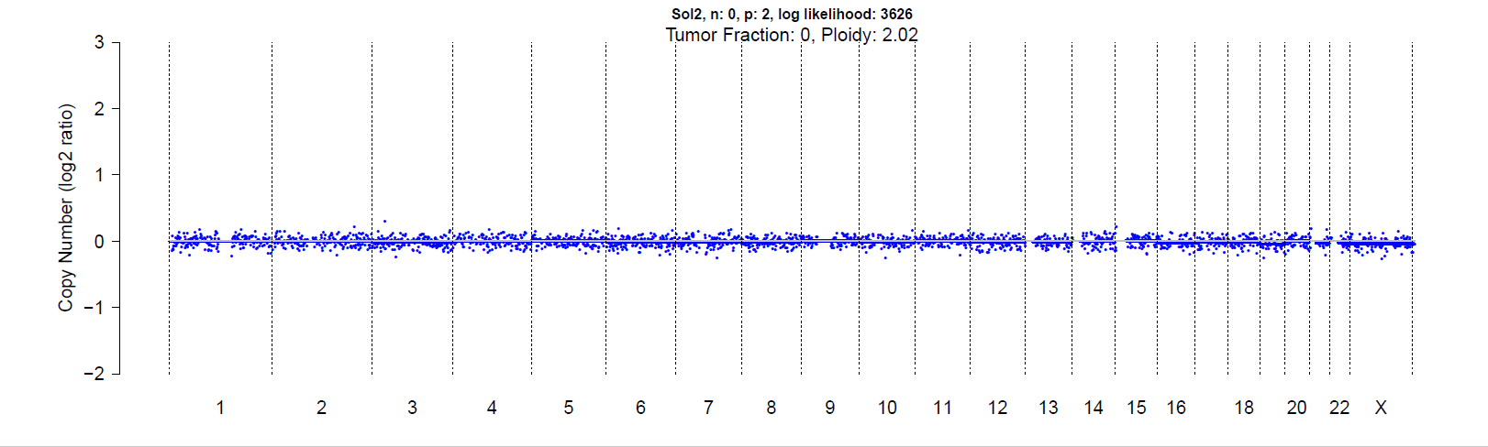
ovarian mature teratoma (neuroglial)
Ovarian Mature Teratoma (skin)

Slide 28
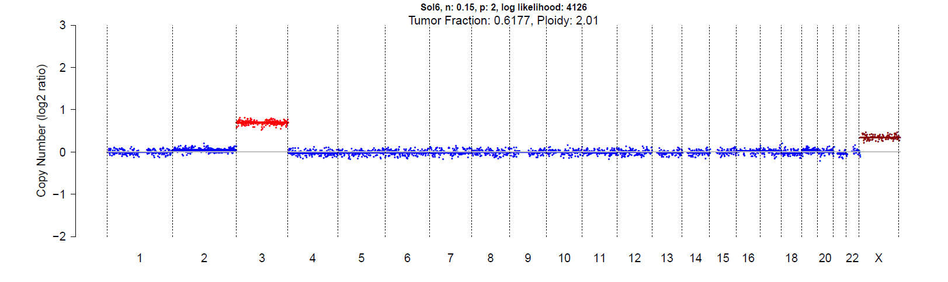
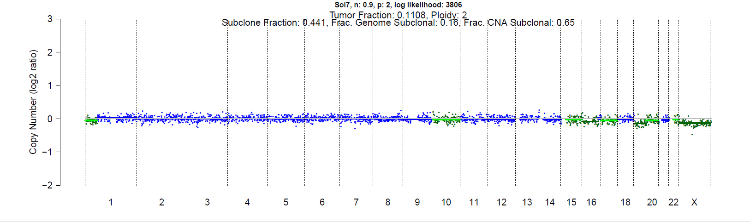
Metastatic Yolk Sac Tumor
Metastatic Mature Teratoma

Slide 29
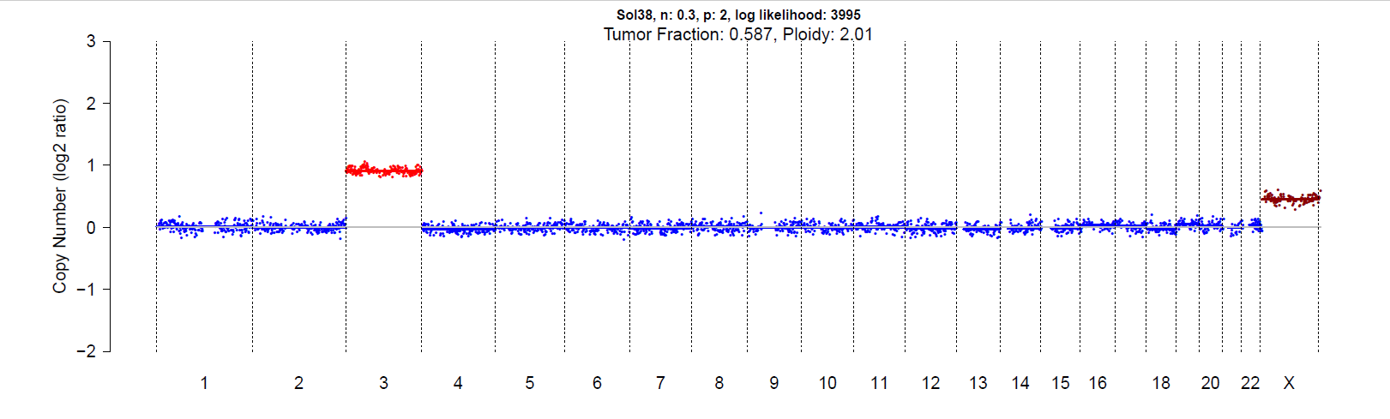

ovarian mature teratoma (skin)
metastatic immature teratoma #2

Slide 30
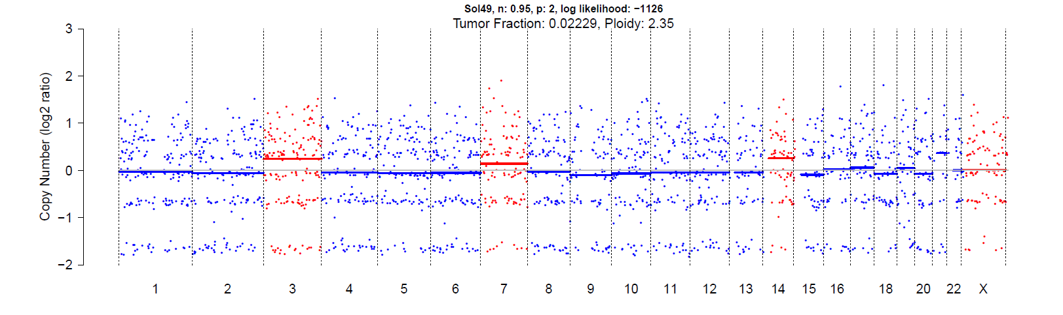
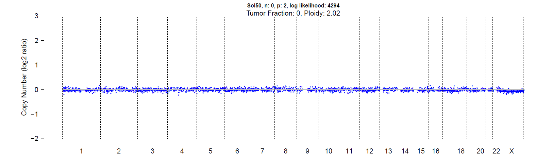
gliomatosis peritoneii
L ovary mature teratoma (neuroglial)

Slide 31
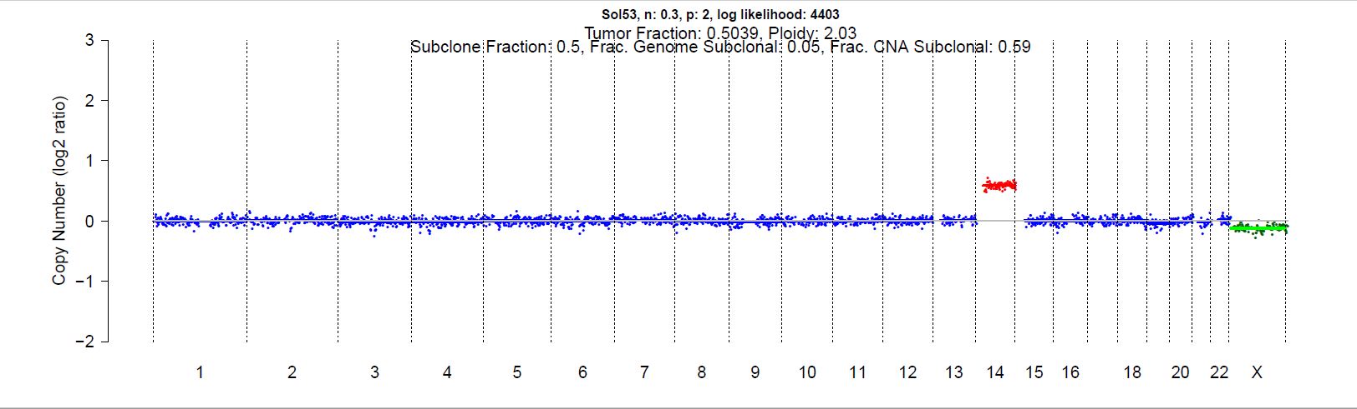
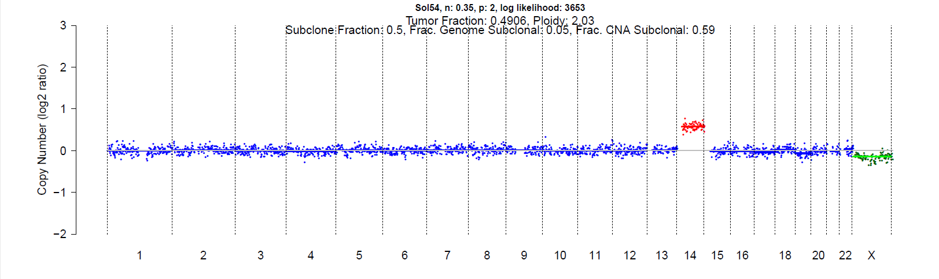
ovarian immature teratoma #1
ovarian immature teratoma #2

Slide 32
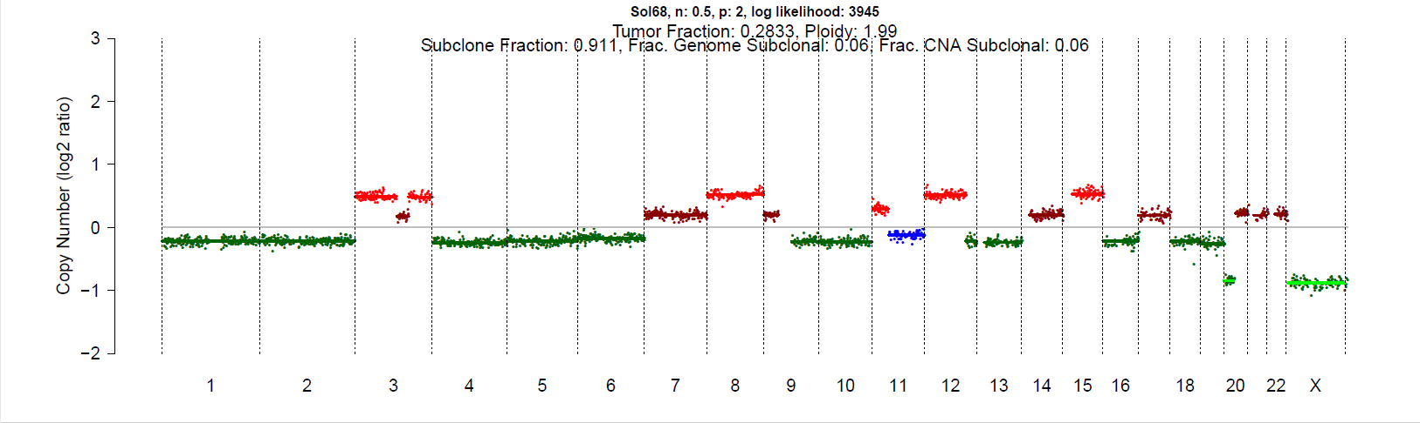
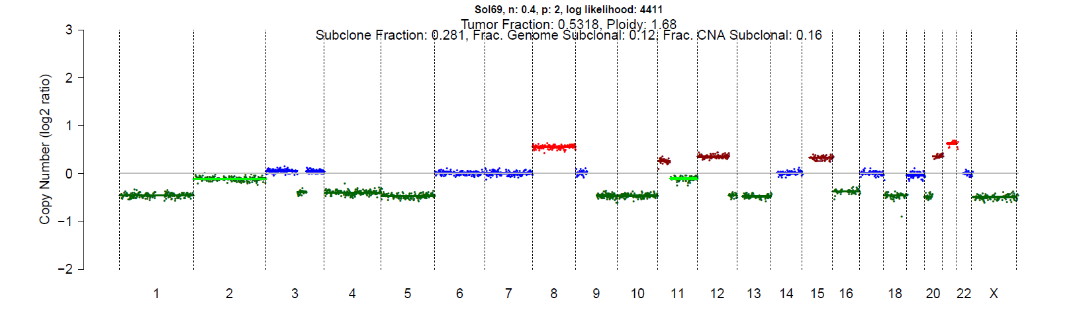
ovarian yolk sac tumor
ovarian mature teratoma

Slide 33
Future Steps
Redo samples with too much noise
Redo samples with too much normal contamination
Perform a CNV Kit analysis to verify the copy number event graphs

Slide 34
Thank you
Michael Heskett
Paul Spellman
Chris Boniface

